Slide 1
ADI’s Software Infrastructure for designing with ADCs, DACs, and Sensors
Presented By
<<presenter’s name>>

Slide 2
Objectives
Let’s get this out in the open: We’re going to be rushed, and we’re not going to transfer much information.
So our objective is to Interest you enough to go back and re-read the material, explore the external links, and re-do the hands on. (These will be also posted on the ADI wiki Github Documentation).
Becoming subject matter expert with every (or “any”, for that matter) of these tools.
Writing full-featured, fancy GUI software
UN-Objectives
Notes:
Really, it’s to build a toolbox of skills related to using device drivers – not anything super complicated, but skills that will help you ask the right questions when acting as the “bridge” between the ADI factory and your customer.

Slide 3
What parts are we NOT talking about?
Networking (ADIN1100, 1200, 2110, etc.)
But ADC/DAC/sensor traffic is perfectly happy swimming through these!
GMSL
Power System Management**
Battery Management System**
** Technically these are ADCs and DACs, but they’ve got their own application-specific software frameworks.

Slide 4
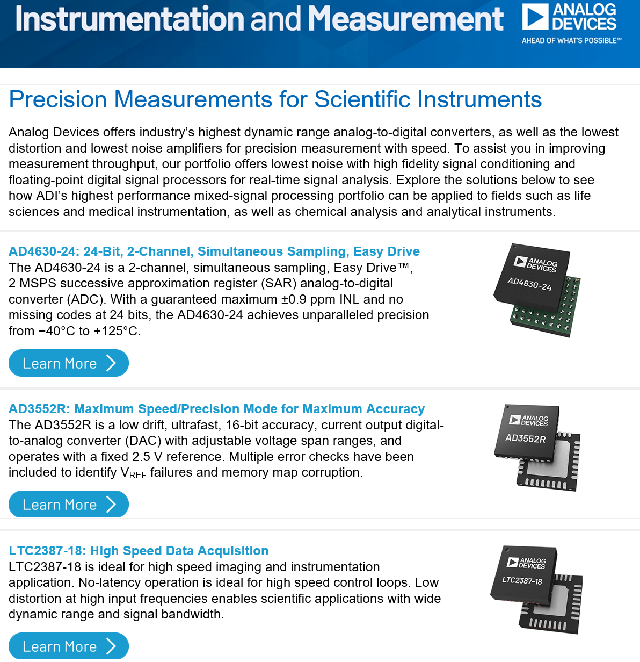
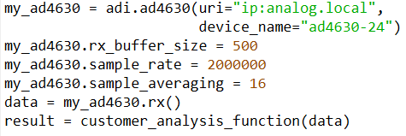
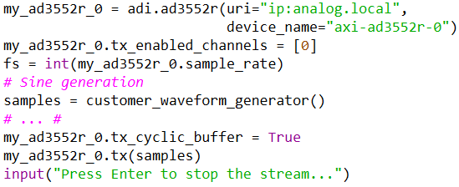
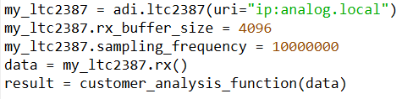
This workshop applies broadly
All of these are complete applications.
Third time recycling this slide, and it’s still relevant.
Notes:
These three devices are being heavily promoted. After this workshop, you should be able to guide the customer to writing their own “just enough software” to analyze ADC data with “customer_analysis_function”, and send data to a DAC from “customer_waveform_generator”.
There may still be quite a bit of work after these initial proof of concept snippets – but if you can get to this point, you’ve climbed a significant portion of the learning curve. (And ideally, sold the customer’s software engineer on the part!)

Slide 5
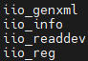
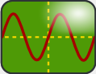

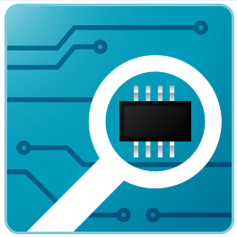
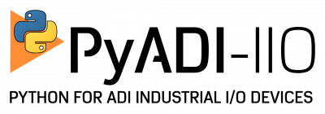

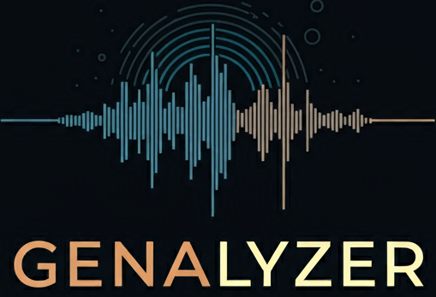
Infrastructure / Tool Summary
Libiio
Built-in utilities
Language bindings
IIO Oscilloscope (Passively being sunsetted)
Scopy
ACE
Pyadi-iio
MATLAB Toolboxes (Precision, Microwave)
Libm2k
Genalyzer
SoundCard (As a proxy for “real benchtop instruments”)
ObsPy (as a proxy for “Customer Signal Analysis
This is a big list – but they apply to thousands of products.
We are going to explore these tools, use them with the AD4080, then show examples of them being applied broadly
Command Line
IIO Scope
ACE
= Pre-installed on Kuiper Linux!
= Request to have pre-installed ☺
= (sudo) pip install ______☺

Slide 6
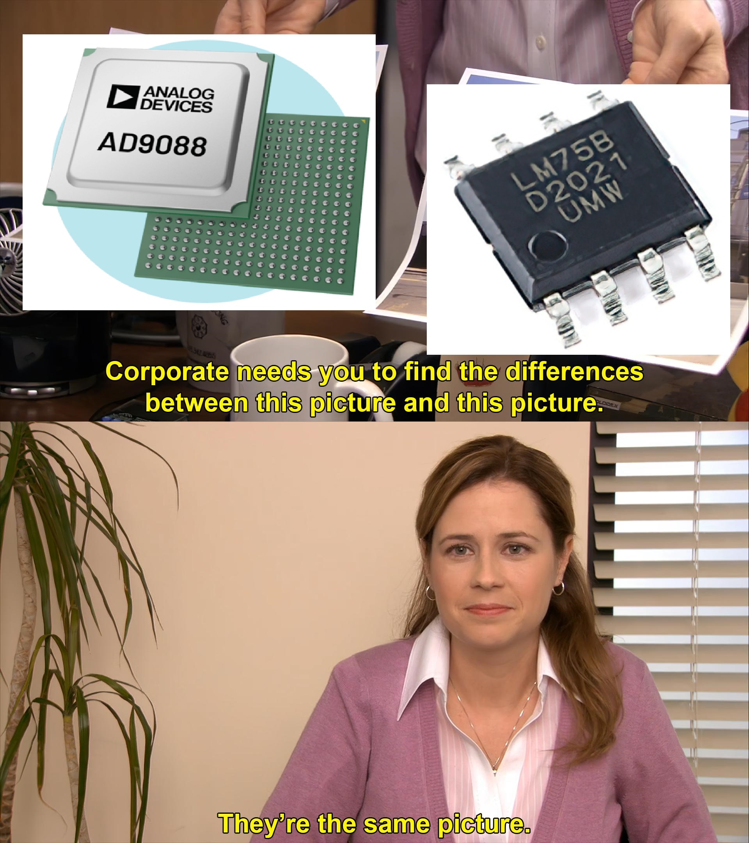
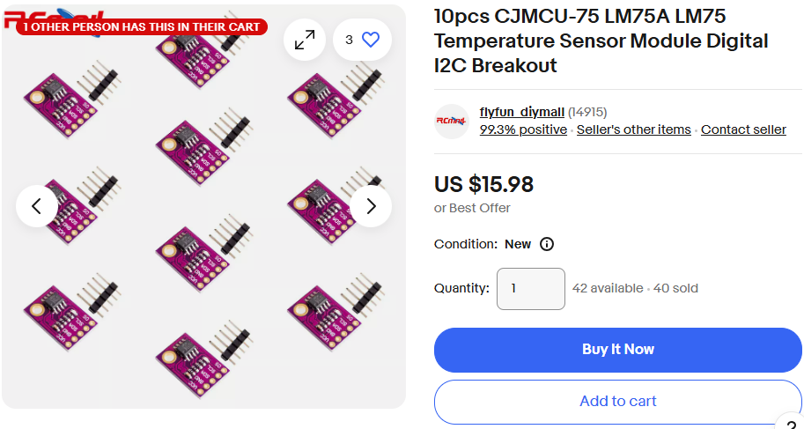
Did we mention this material applies broadly?
If you want to understand how this all relates to our most complicated part, start with our simplest part.
More economical, too.
($16 for a ten pack of breakout boards!)

Slide 7
IIO / LibIIO

Slide 8
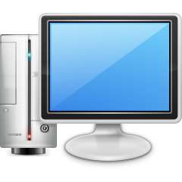

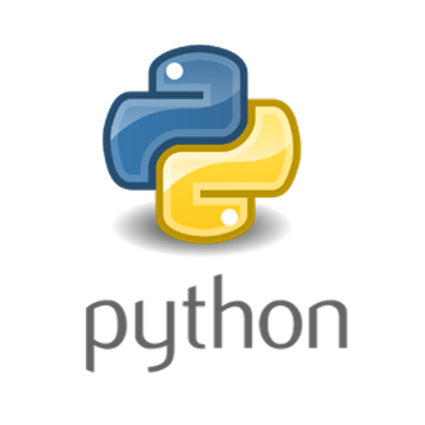
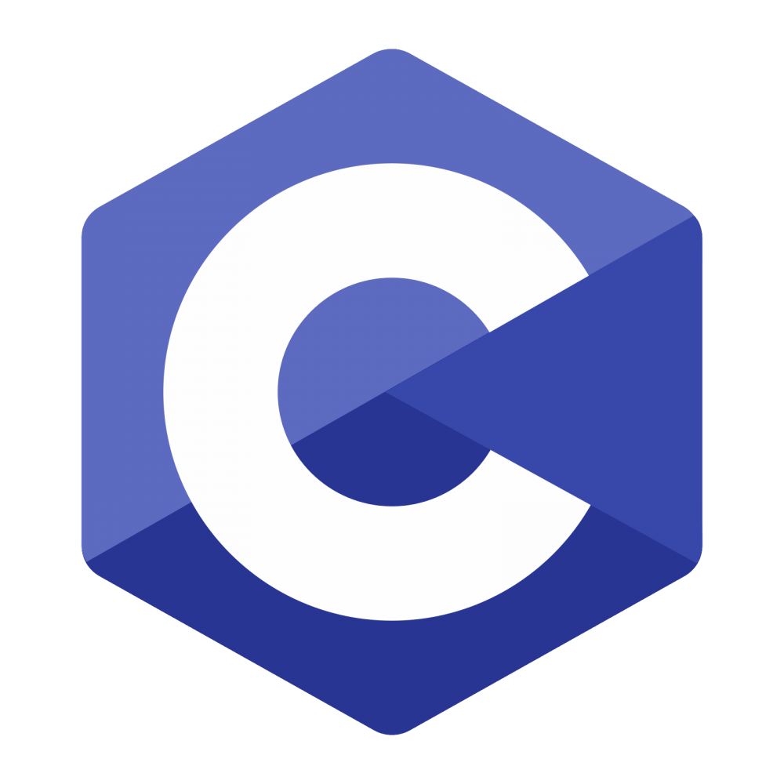
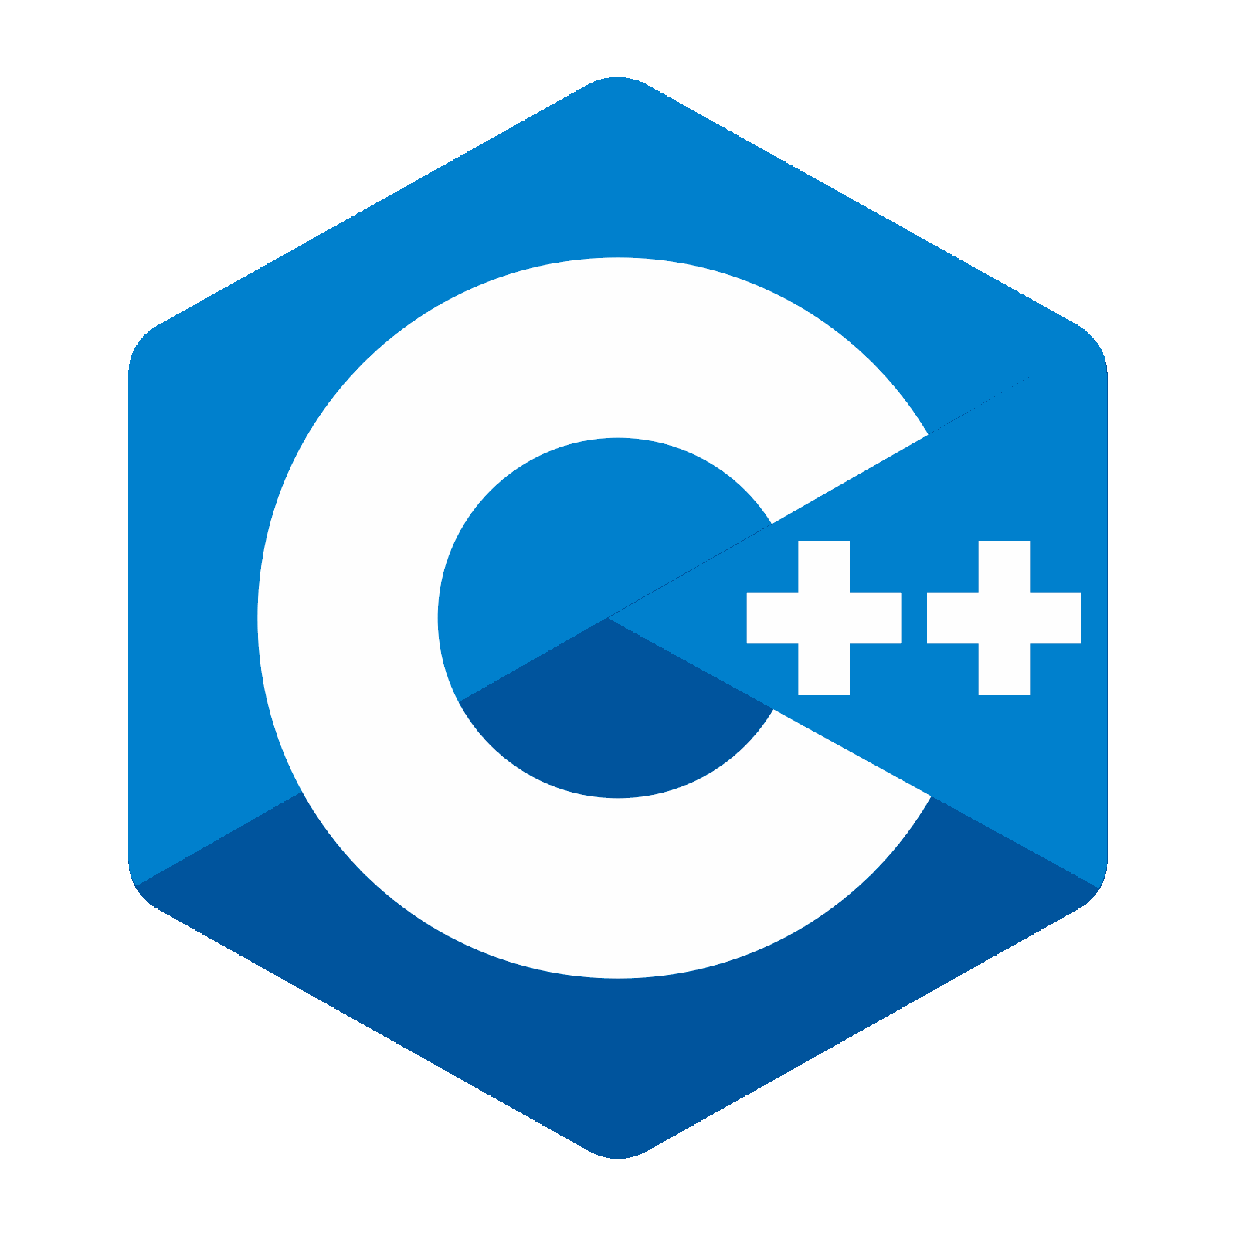
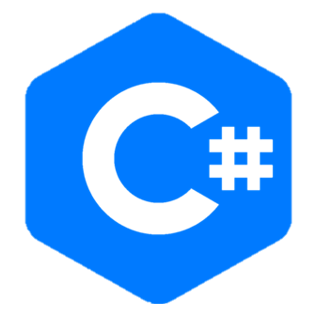
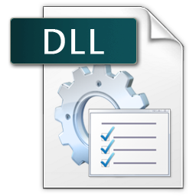
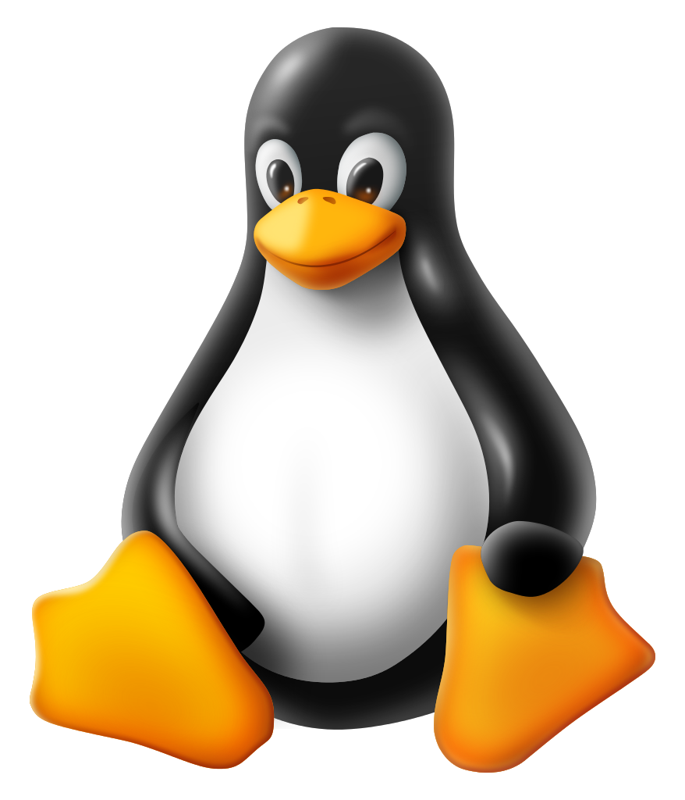
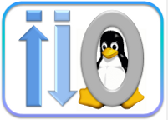

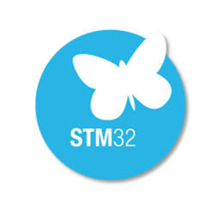


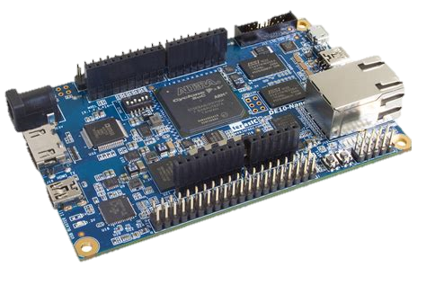
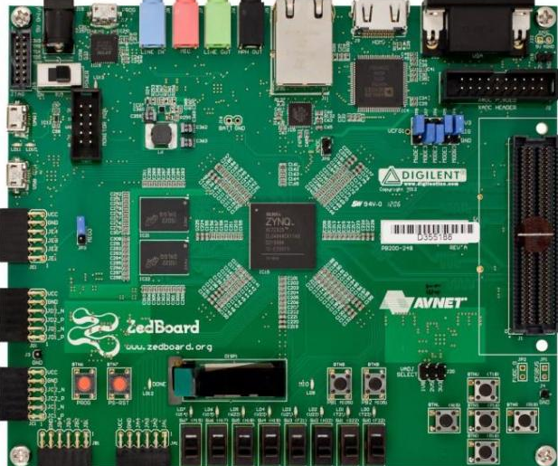
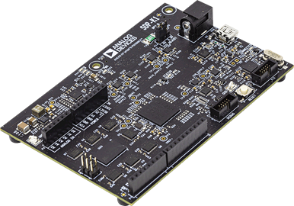
Flexible, IIO-based System Architecture
…
Scopy
IIO Scope
LabVIEW
ACE
Command Line
Some of these tools can also run locally on the Linux platforms.
This enables development of software on a PC, and then migration to run directly the Linux platform
Using libiio client installation, tools running on a remote PC can configure, capture data or generate waveforms as if they were running locally on the remote host.
Facilitates easier development with more powerful development environments
libiio.dll
libiio.so (Linux)
Embedded Linux
Embedded Firmware
On Linux, IIO is a kernel subsystem.
Provides a way to configure and capture data or generate waveforms for converters
Tinyiiod can be used with Mbed and other embedded RTOS’s.
Provides a way to configure and capture data or generate waveforms for converters
…
…
Notes:
The use of IIO to manage the data & control interface between a host and the target board allows the customer to use a wide variety of tools for extended evaluation and prototyping.
Because the embedded platforms are common, the tools can be used interchangeably, at any stage during the design-in process

Slide 9

IIO Review
What:
Linux kernel Industrial Input / Output framework
All non-HID I/O
ADC, DAC, TRX, light, accelerometer, gyro, magnetometer, humidity, temperature, pressure, rotation, angular momentum, chemical, health, proximity, counters, amplifiers, synthesizers, etc.
Why:
“With the growing number of sensors (measurement devices with analogue-to-digital, or digital-to-analogue, capabilities) with different code implementations scattered over the kernel sources, gathering them became necessary. This is what the IIO framework does, in a generic and homogeneous way.”
libiio is the API into the IIO framework, and IS an ADI project.
In the upstream Linux kernel for more than 10 years.
**libiio is CROSS Platform, with LOTS of language bindings **
https://www.kernel.org/doc/html/latest/driver-api/iio/index.html
Notes:
This is a bit abrupt, but we need to introduce IIO at this point – IIO is a framework for a wide variety of hardware peripherals. It is NOT an Analog Devices invention, it is an industry standard that has been in the Linux kernel for more than ten years.
You can think of it as a “unifying force” for writing software that interacts with hardware, with some extraordinarily powerful features. While the devices themselves need to be physically connected to a Linux based machine, the IIOD server exports devices over network (and other) connections, allowing software to be developed and run on a Windows, Mac, or Linux host. Furthermore, there are language bindings for C, C#, MATLAB, Python, Rust, and more. These are consistent across platforms.
The “Why” paragraph is from Linux Device Drivers Development by John Madieu
https://www.oreilly.com/library/view/linux-device-drivers/9781785280009/cb05cd5a-9250-44a7-9675-bd7ea6cd9f51.xhtml
<<Thoren’s perspective>> If you’ve listened to me (Mark Thoren) pontificate over IIO – it is for a reason. I’ve spent two decades developing, and helping others develop ad-hoc evaluation systems, lab bench evaluation setups, customer debug setups, and all manner of hacked setups. They all got the job done, and were done with time, resources, and funds at hand. And they are all terrible in one way or another – unsustainable, one-off, undocumented, etc.
IIO SOLVES 90% of the issues I’ve had over those years. After you get over the initial learning curve and time investment, the long-term benefits are unquestionably worth it.

Slide 10
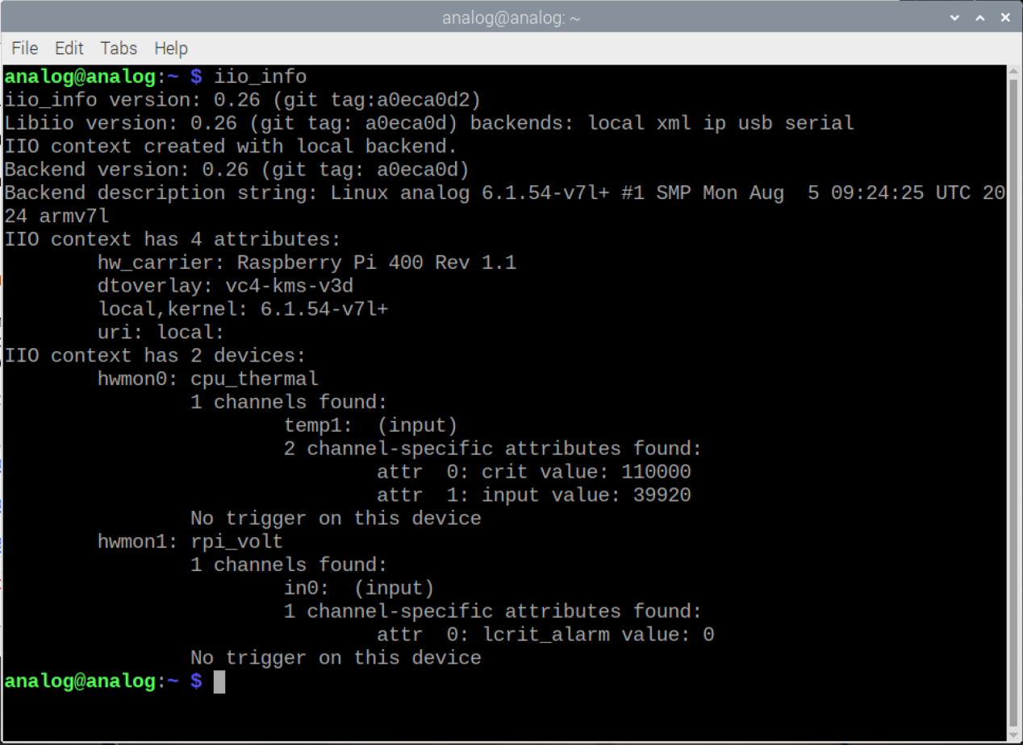
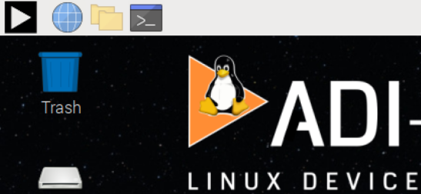
Hands On: Let’s run some libiio utilities
We have THREE IIO contexts in front of us, let’s check them out!
Open a terminal, run:
iio_info
iio_info –u serial:/dev/ttyACM0,230400,8n1
iio_info –u ip:m2k.local
~/Desktop/ftc24-ws/hello_cputhermal.sh
(These commands are in the commands.txt file on the desktop for copy/paste.)
Terminal

Slide 11
Kuiper Linux on RPi 400 Cheat Sheet
Copy / paste from text editor – CTRL-C, CTRL-V just like in Windows.
HOWEVER – in the terminal, it’s CTRL-SHIFT-C, CTRL-SHIFT-V
ALT-TAB to switch between applications, just like windows. (Handy to switch between PDF of this presentation and what you’re working on)
Fn up arrow / down arrow for page up / down.
Right-click PDF, open with PDF viewer (default is Chromium, the viewer is better.)
In the terminal, up-arrow to scroll through last commands
In the terminal, you can start a command or path, then hit TAB to autocomplete.
(If it’s ambiguous, type the next character, then tab again.)
Path separators are FORWARD slashes (/), like Mac, but UNlike Windows (which uses backslashes)
Common commands:
cd Change Directory
ls –la List directory contents, with details
~ (tilde) is shorthand for “home directory”. So cd ~ will take you home.

Slide 12
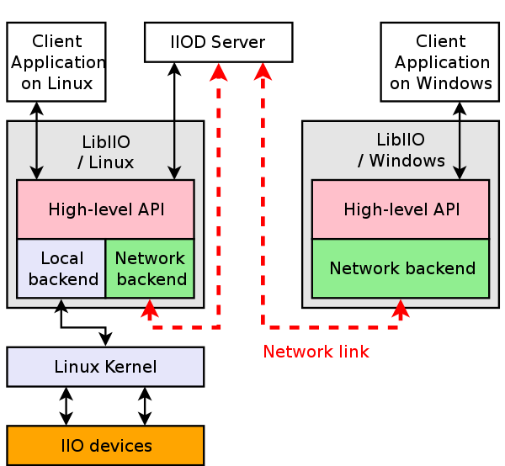
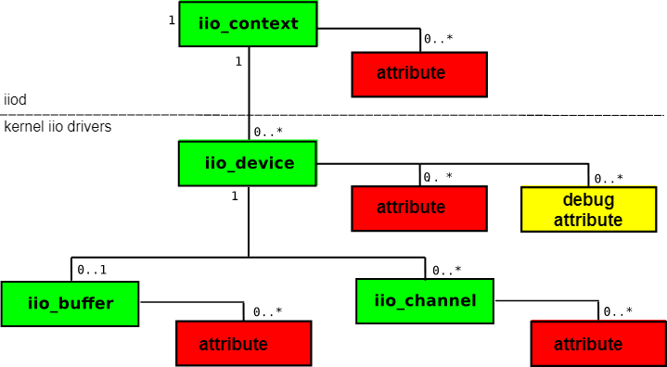
One Slide Glossary: Contexts and Devices and Attributes… oh my!
An iio_context is “A collection of IIO devices”
Usually, one processing board represents one context.
An iio_context object may contain zero or more iio_device objects.
An iio_device object is associated with only one iio_context.
An iio_device may have zero or more attributes
The output from iio_info can be re-drawn as a “tree”, if that’s more intuitive:
Notes:
There’s a lot of terminology associated with IIO, but the one we’re going to focus on for the next few slides is “context”. A Context is a “collection of IIO devices” connected to one “computing device”, like a Raspberry Pi, FPGA platform board, or even a microcontroller.
And a little quiz for those of you that have seen the phaser or attended one of our workshops – how many contexts does the phaser setup have?
The answer is two – there’s the Raspberry Pi that talks to the beamformer chips and the synthesizer over the SPI bus, as well as a little I2C housekeeping ADC. The other context is the Pluto, which itself runs a small but complete Linux system.
From the viewpoint of a program running on the Raspberry Pi, the stuff on the SPI and I2C bus are the “local” context, because they are connected directly to the Pi.
The Pluto is connected by a USB cable, and is accessible both through a USB backend and a network backend
So my Python program running on the Raspberry Pi can talk to everything just fine, and this is how we usually run the workshops, with a monitor and keyboard attached directly to the Pi, no external computer required.
BUT – often times we DO want to talk to the phaser from an external computer – the Pi has “limited processing power”, it can’t run MATLAB**, and certainly can’t run Windows applications.
** It is possible to generate C code from MATLAB that can be compiled to run on the Raspberry Pi, but there are limitations and you can’t run the MATLAB editor / IDE on the Pi.

Slide 13
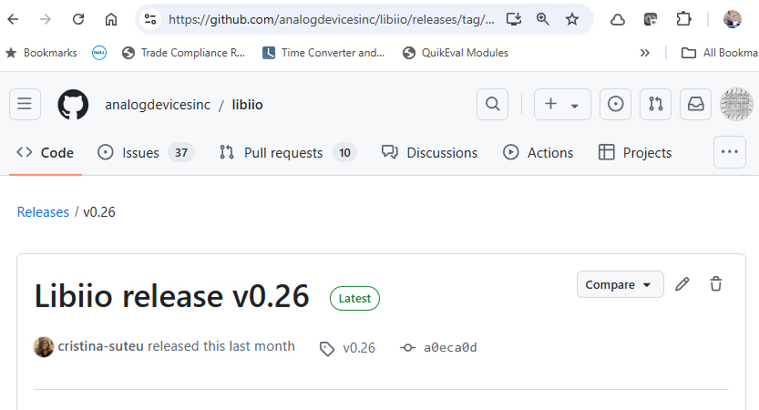
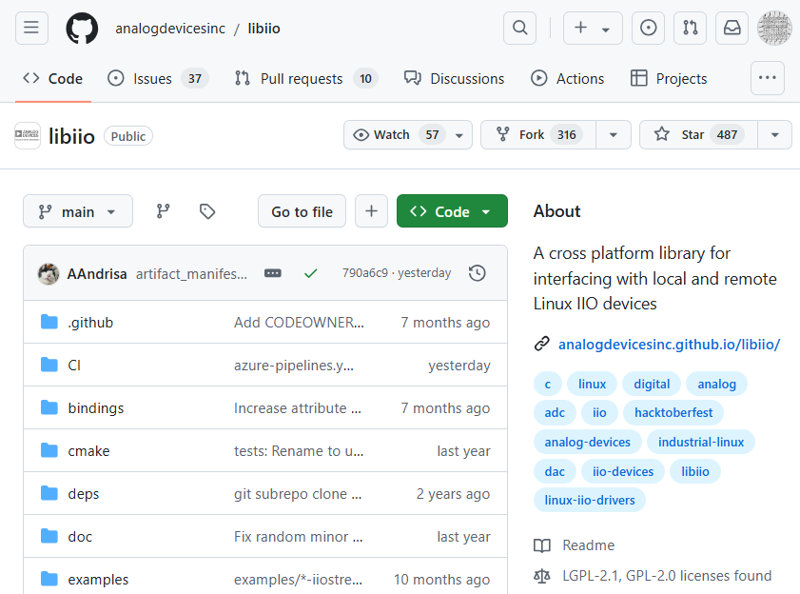
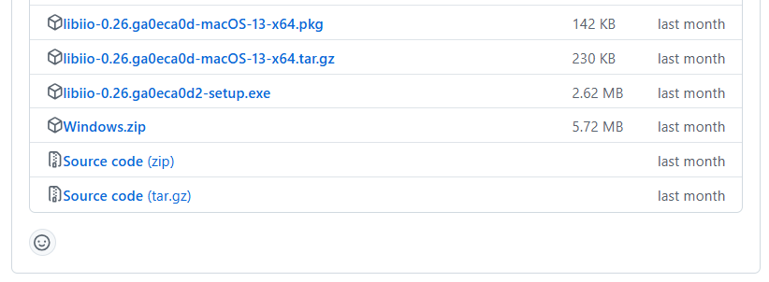
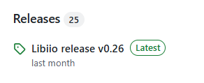
Installing libiio
https://github.com/analogdevicesinc/libiio/
Recurring Theme:
Source, Installers, Documentation all maintained together!

Slide 14
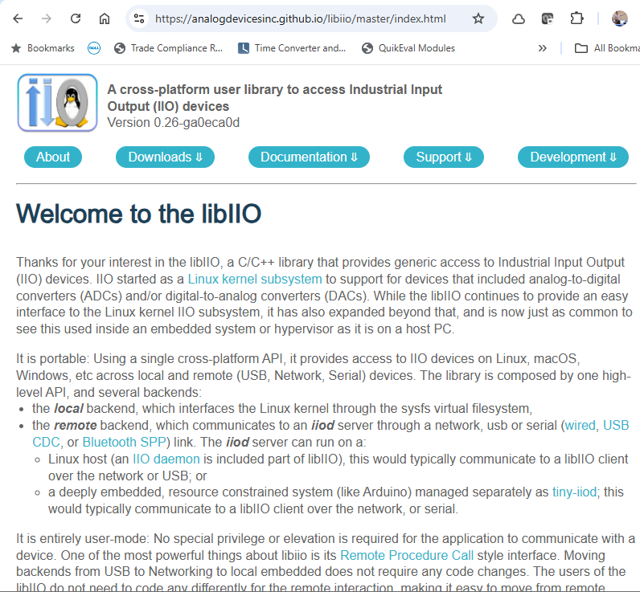
Libiio Documentation
http://analogdevicesinc.github.io/libiio/

Slide 15
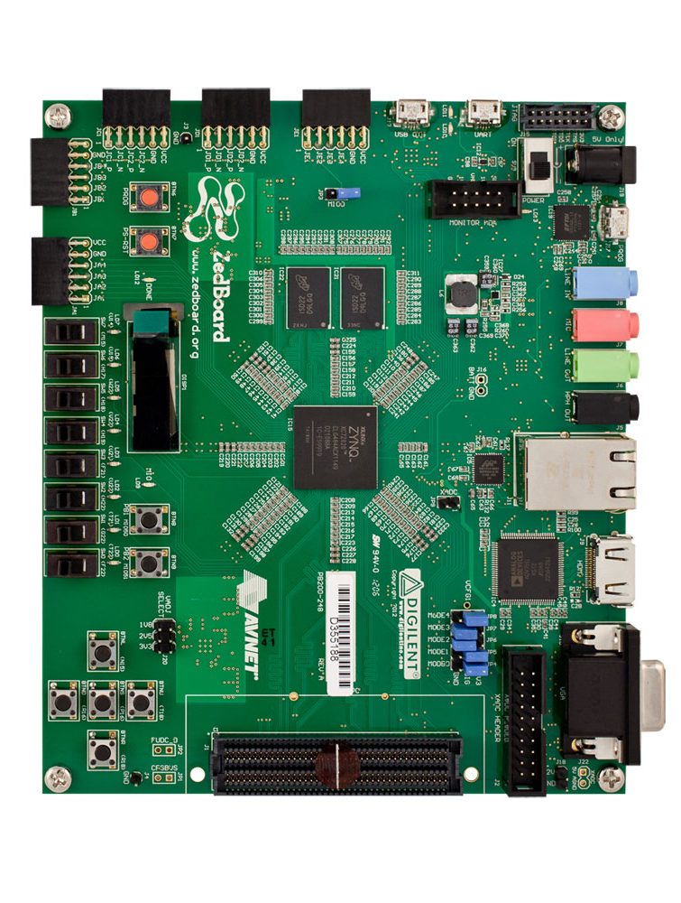
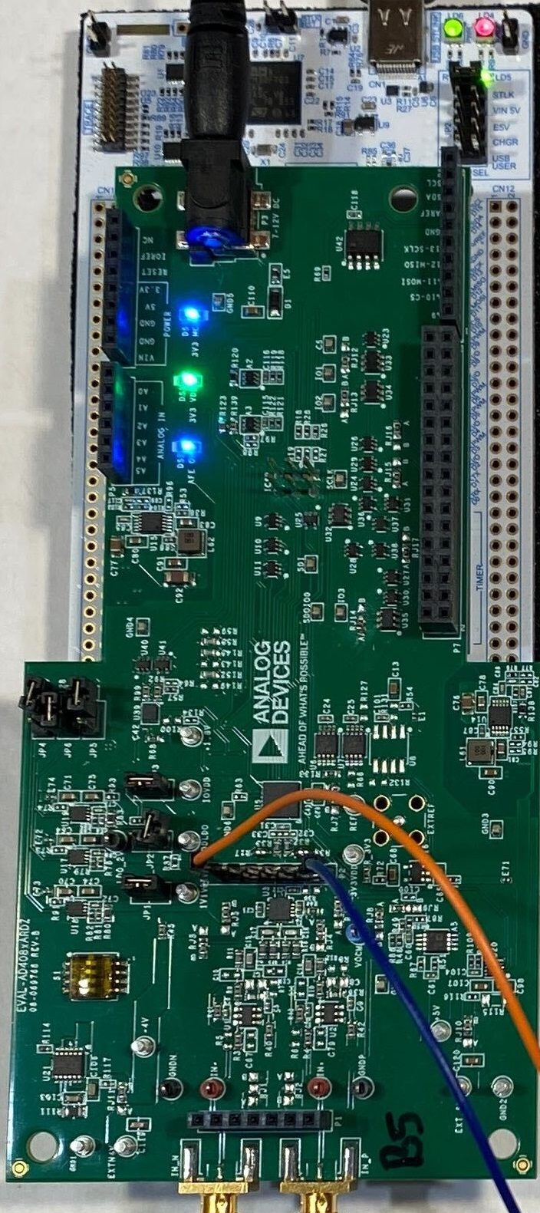
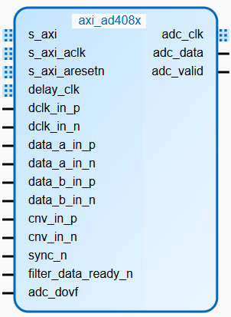
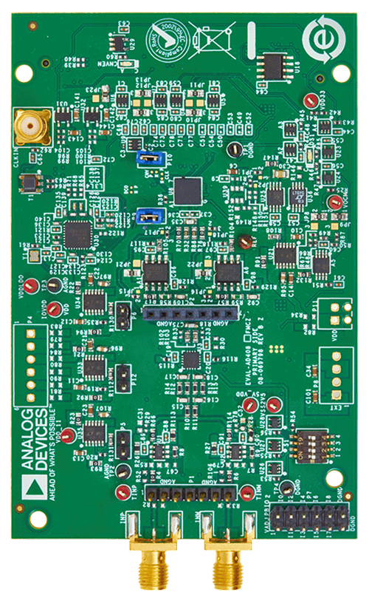
HW/SW Stacks for the AD4080, why two choices?
Pretty GUI
Pretty GUI
Algorithms, number crunching
Your Windows/Linux/Mac machine
Algorithms, number crunching
FPGA for continuous streaming, wideband applications.
uController for lower bandwidth, standalone applications (internal FIFO only).
Pyadi-iio
Pyadi-iio
Bindings (Python, C#, MATLAB, etc)
Bindings (Python, C#, MATLAB, etc)
libiio
libiio
USB Serial
Ethernet
tinyiiod
Libiio / iiod
No-OS Device Driver
/sys/bus/iio/../../
Platform Driver
Linux Device Driver
SPI, for both data and config.
Platform Driver
Platform Driver
AD4080
Custom HDL (for data)
SPI (for configuration)
SPI w/ 2 CS, one for data, the other for config.)
AD4080
Serialized LVDS
SPI (LVCMOS)
Notes:
The AD4080 is fairly unique in that it has two eval boards, at opposite ends of the performance spectrum.
The “full performance” board on the right has an FMC connector and targets the ZedBoard. There is a custom HDL core written in Verilog that negotiates the high-speed data from the AD4080, and reformats it into an “AXI Stream” interface, a standard interface for passing data around in an FPGA.
There’s also an associated Linux driver for configuring the part, and the “payload” data re-uses the same DMA driver we use all over the place.
In contrast, the Arduino form factor board targets either the SDP-K1 or an ST Nucleo board.
The firmware is in the no-OS framework, and implements a “tinyiiod” server, allowing the same standard toolset to be used.
There is a limitation to the part in which the CMOS / SPI data transfer must use the internal FIFO, so only burst captures of up to 16384 (2^14) samples are allowed.

Slide 16
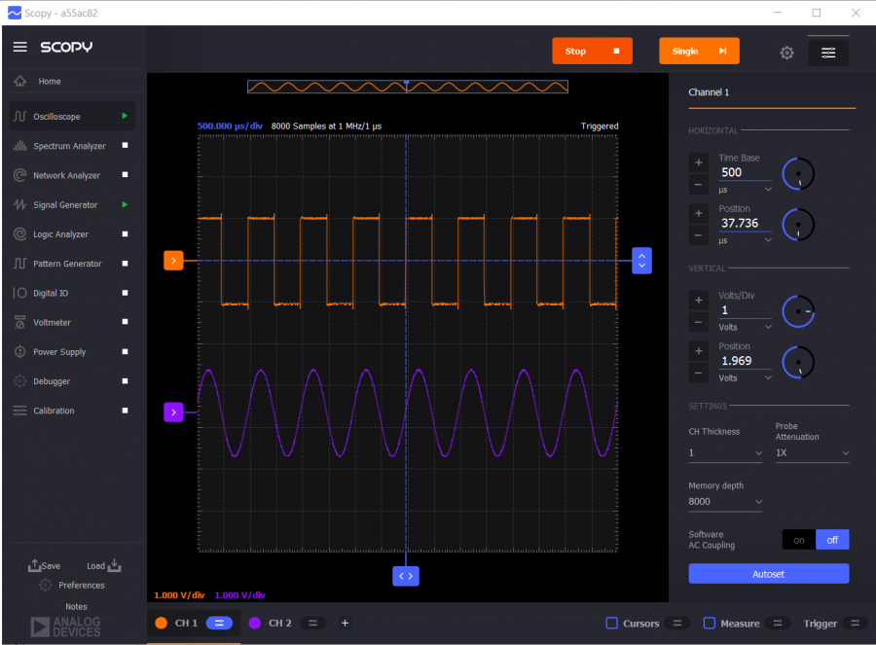
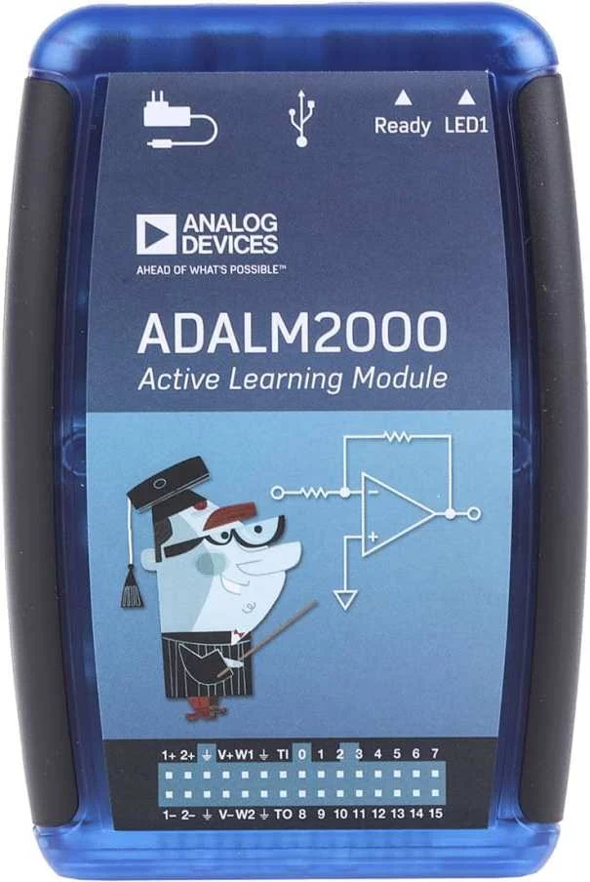
ADALM2000 / Scopy stack looks awfully familiar
Every nanosecond you spend studying the m2k stack applies to real life.
libm2k native C++ API
libiio
USB (or Ethernet over USB)
Libiio / iiod
/sys/bus/iio/../../
Device Driver
Custom HDL, often with separate control and DMA paths
ADC, DAC, etc.
Notes:
As usual, we don’t like to do any extra work. The ADALM2000 re-uses the same drivers, HDL, etc.

Slide 17
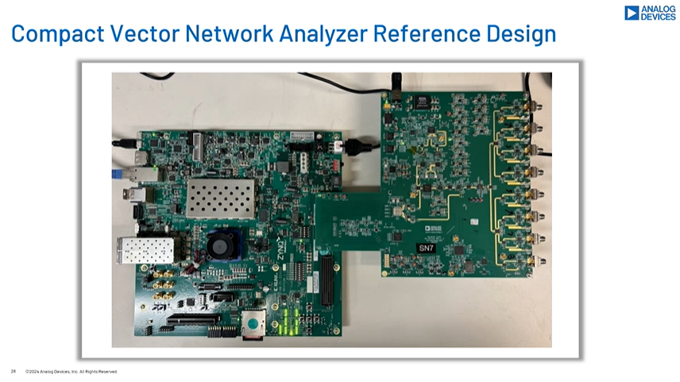
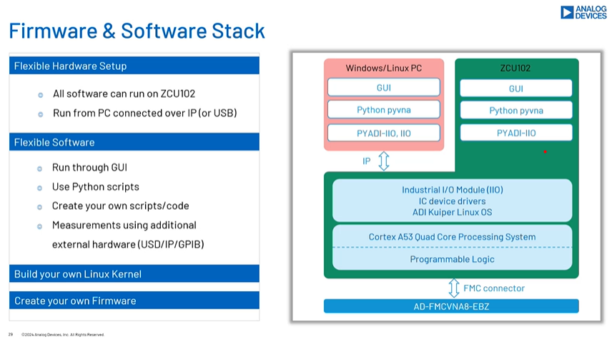
Libiio “mini case study”
During a presentation on the Compact 8-channel VNA, A question came up in the Q&A – what is the API? Is it register read /writes?
The question had been answered earlier on in the presentation ☺
This slide implies compatibility with Windows/Linux/Mac/C/C++/C#/MATLAB/Python.

Slide 18
Hello, AD4080, ADALM2000, and Scopy…2!

Slide 19
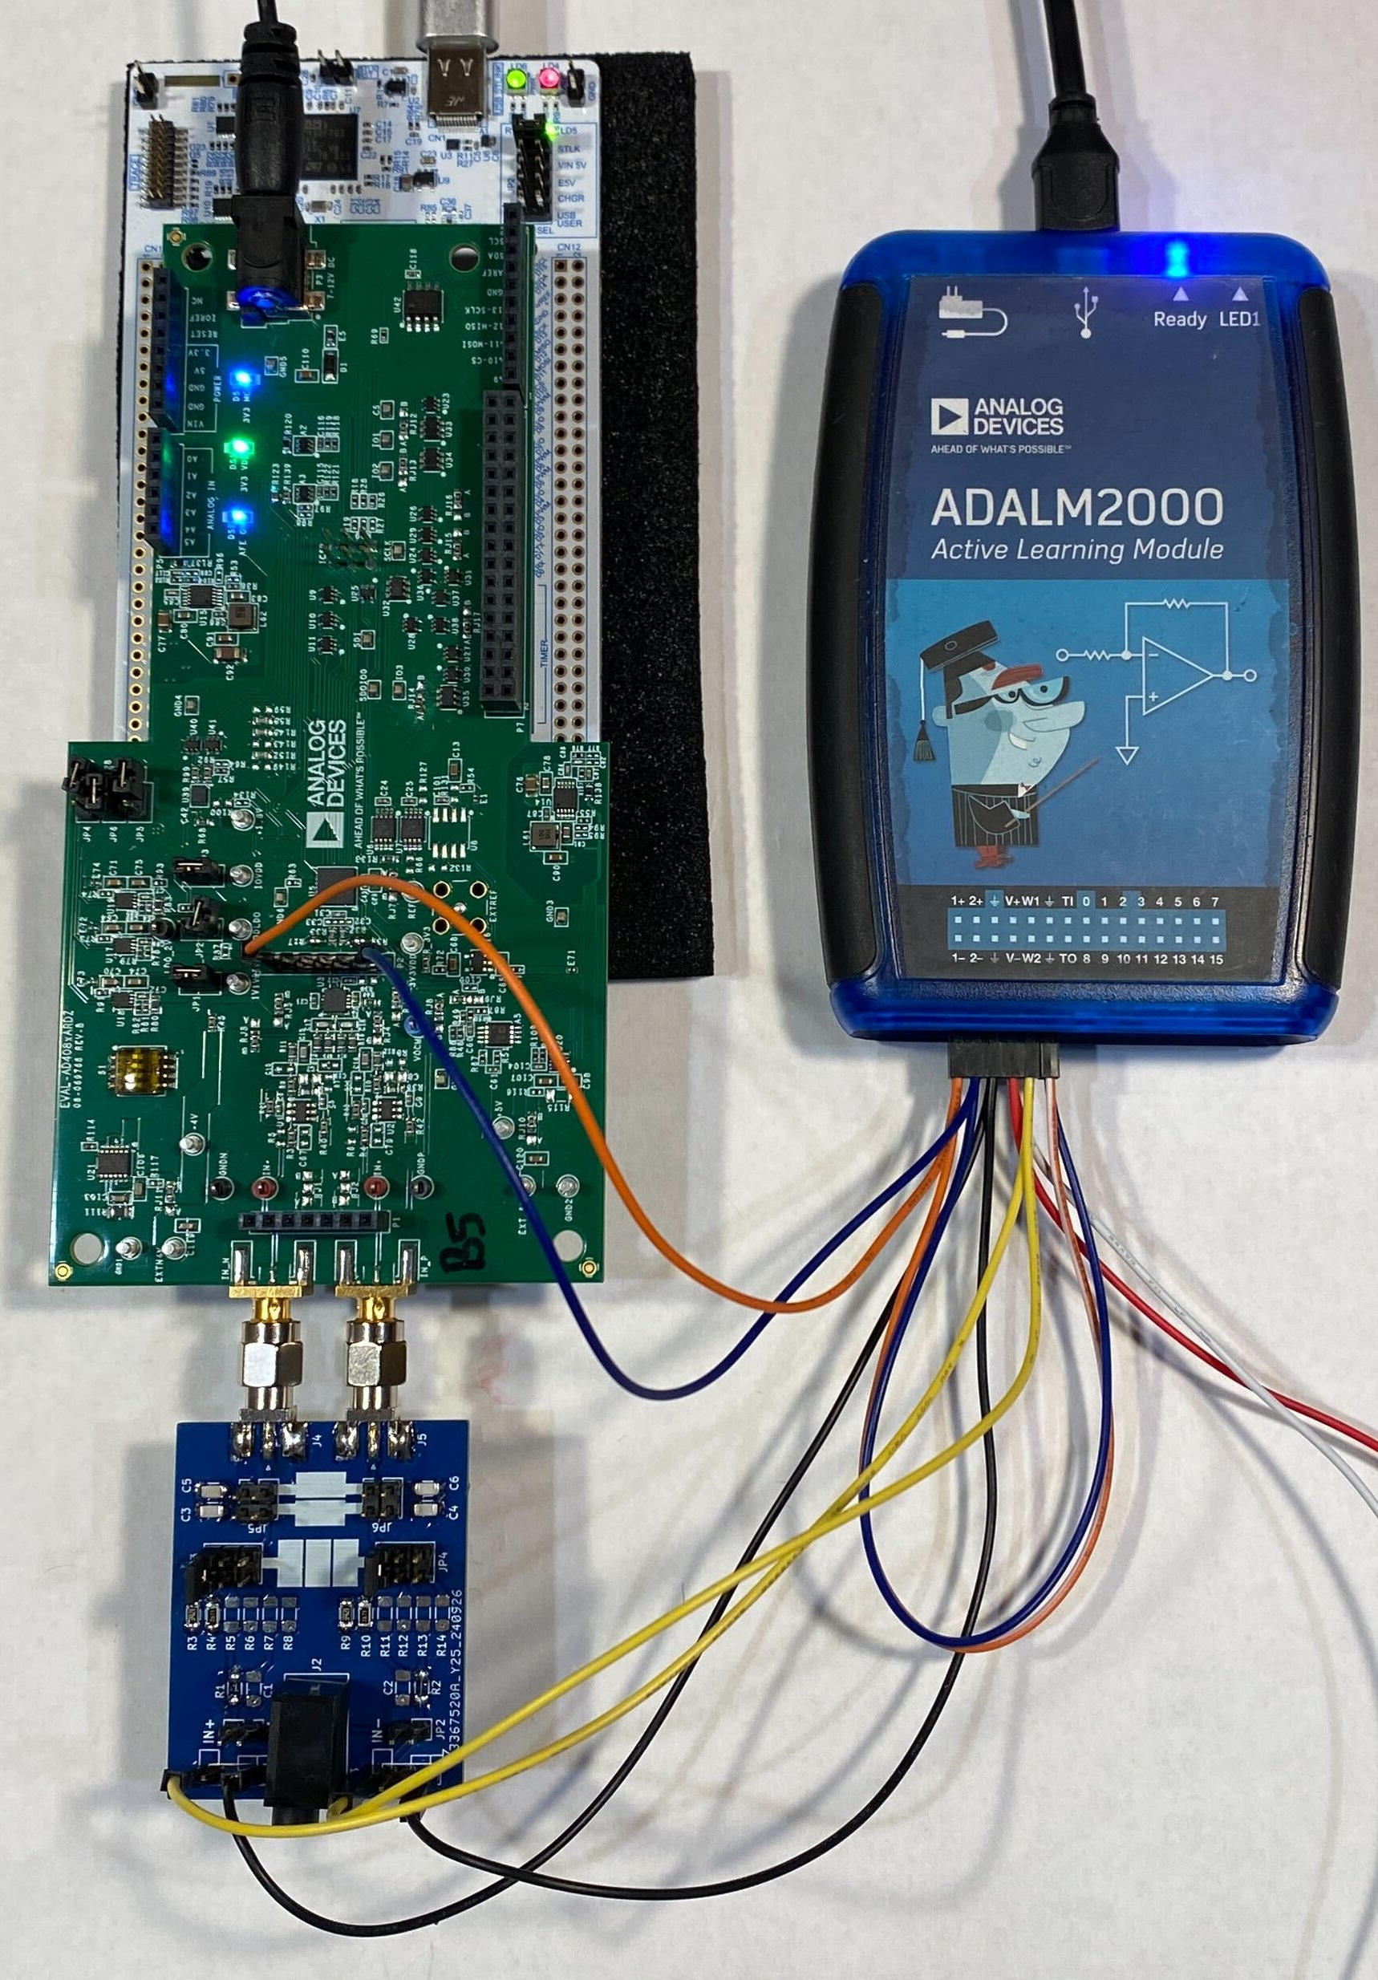
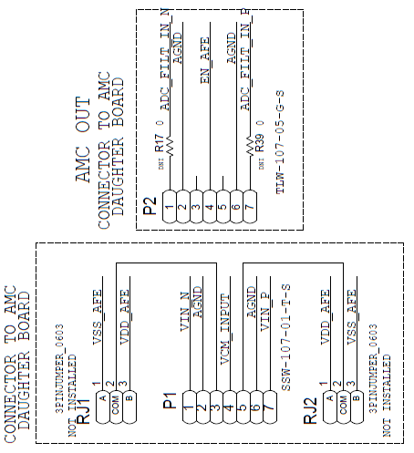
Hardware Setup
Shopping List:
Raspberry Pi 400 (or 4)
EVAL-AD4080-ARDZ eval board
Tensility 16-00078 / DigiKey 839-1671-ND 12 V adapter
ST Nucleo-H563ZI
ADALM2000 / Nucleo plugged in
Either 1k series resistor, or 2k/3k atten.
Connections:
W1 – IN- on adapter (mislabeled)
W2 – IN+ on adapter (mislabeled)
1+ to P2, pin 1
1- to P2, pin 7
1-, 2- to m2k GND pins
M2k 2+
M2k 1+
M2k W2
M2k W1

Slide 20
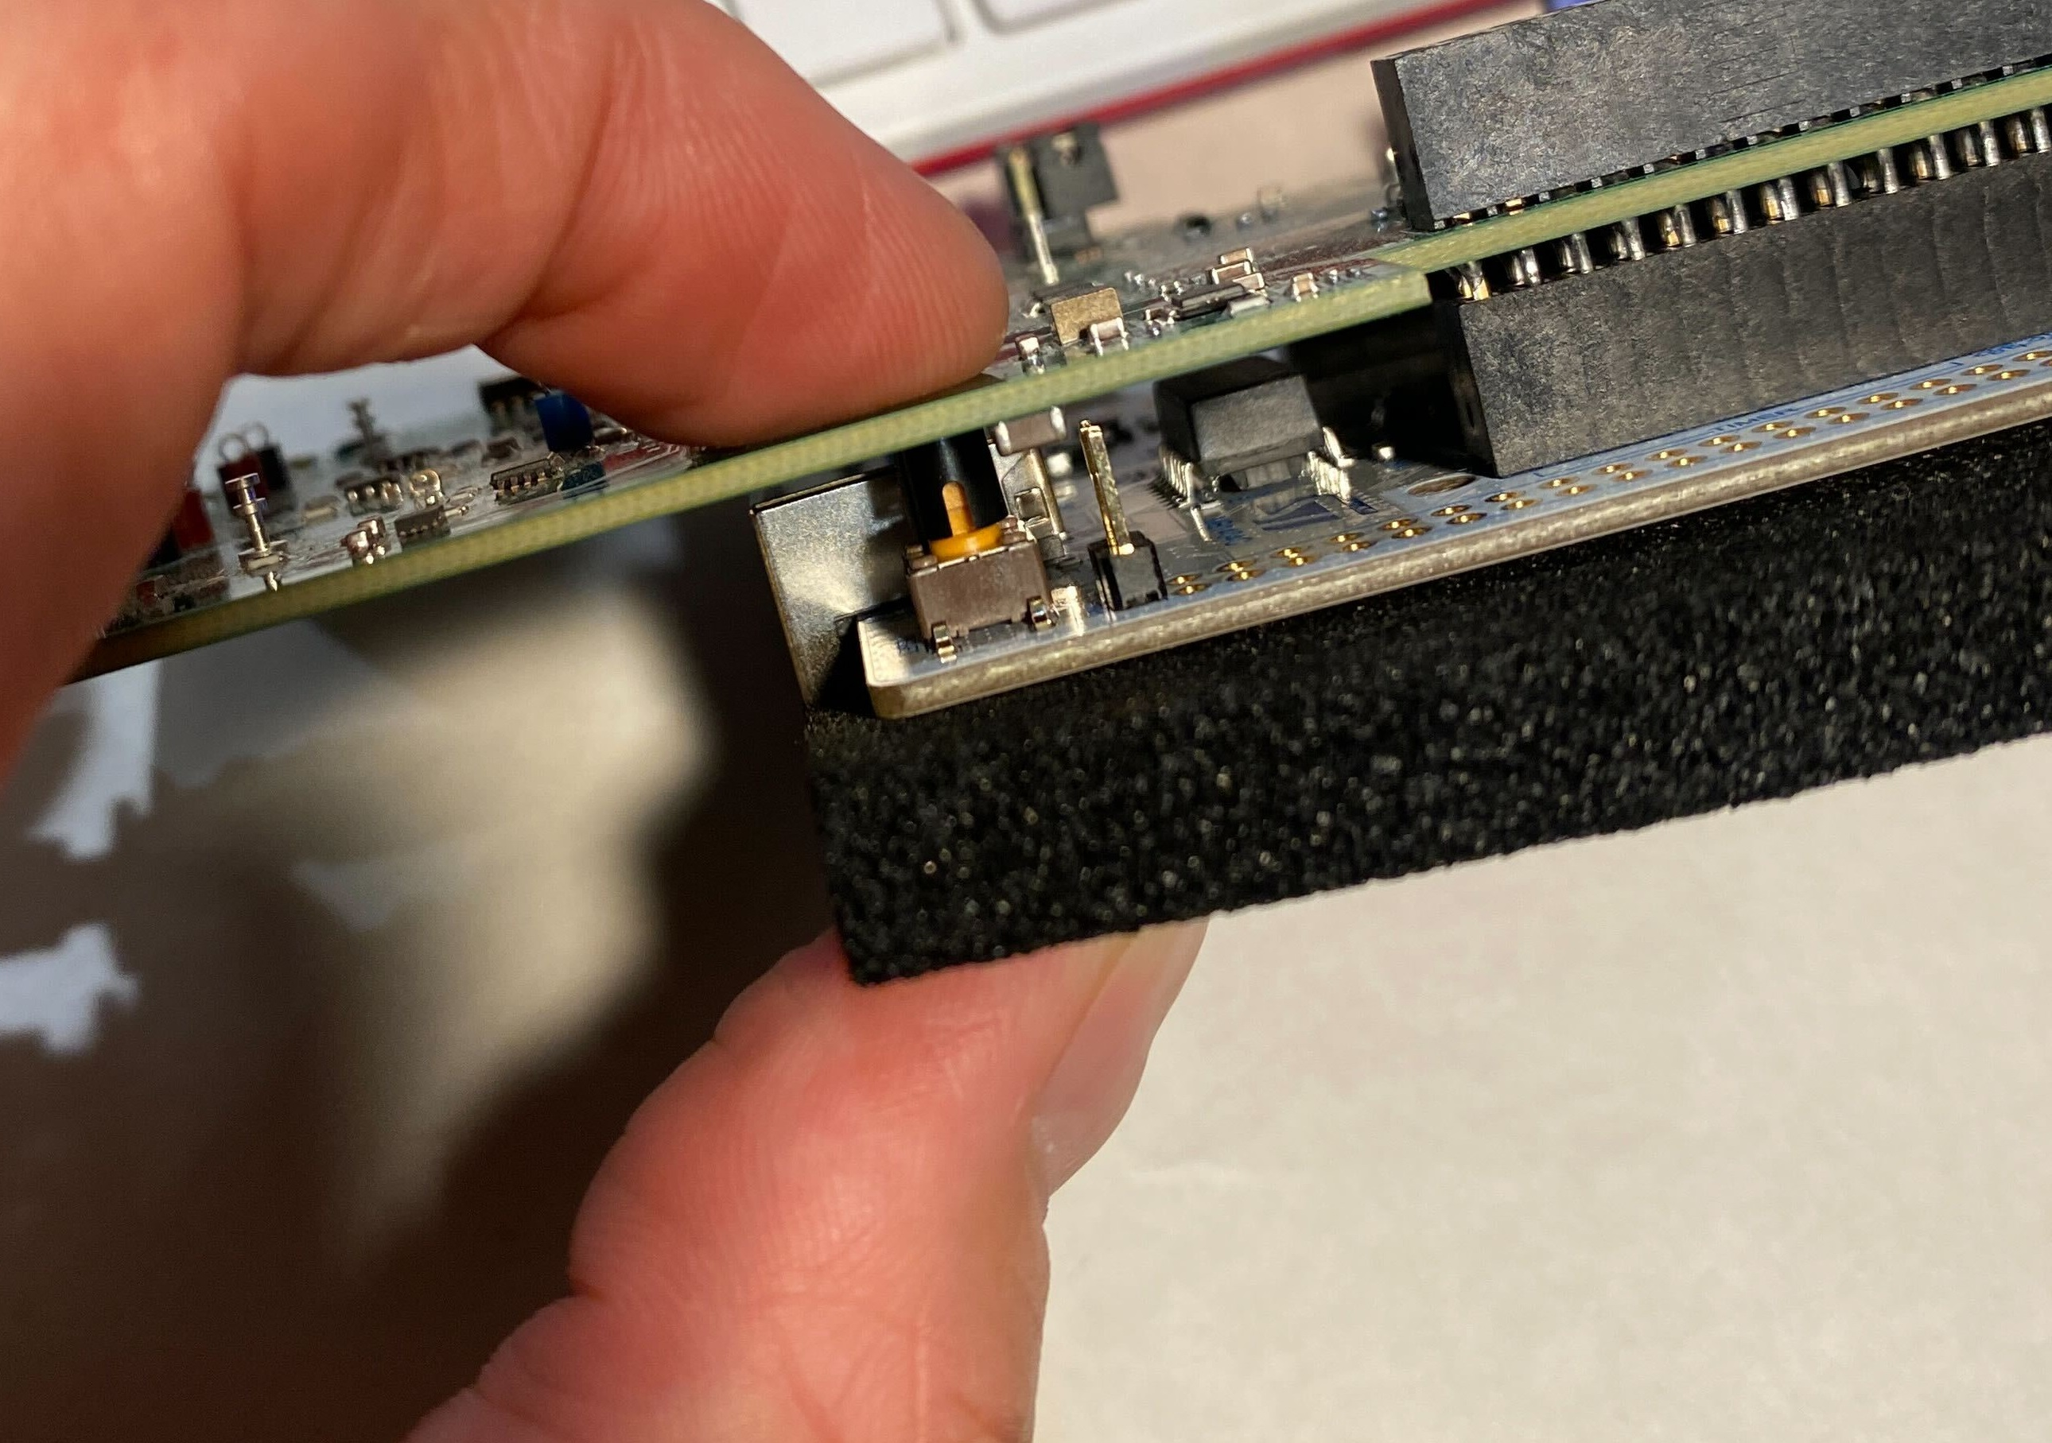
Hidden Reset Button, and a note about /dev/tty ports…
We shouldn’t need to reset the Nucleo / tinyiiod server… but if we do, you can actuate the button by gently pressing the top of the board near the GND3 test point.
One example, if a Python script fails with a “Connection Timed Out” error, reset the board and re-run the script.
Also, it’s possible that the USB serial port assignment can vary. If things just aren’t connecting, flag us down.

Slide 21
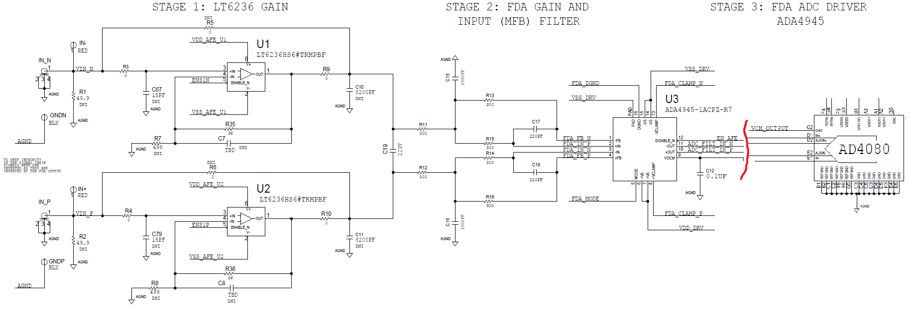
AFE snippets, for reference
M2k W2
M2k 1+
M2k 2+
M2k W1

Slide 22
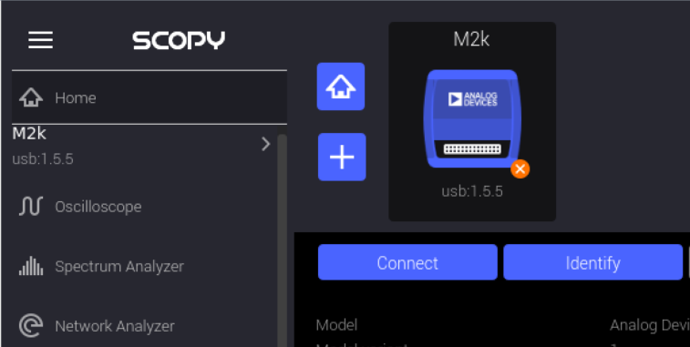
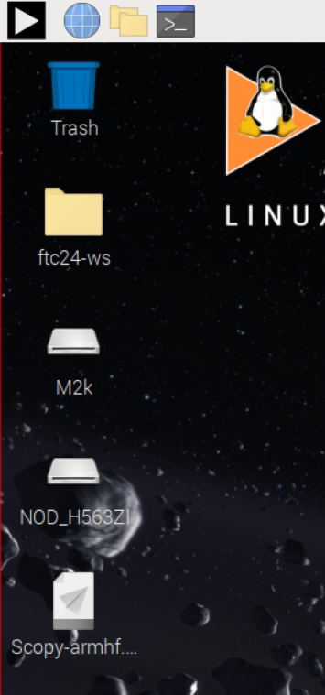
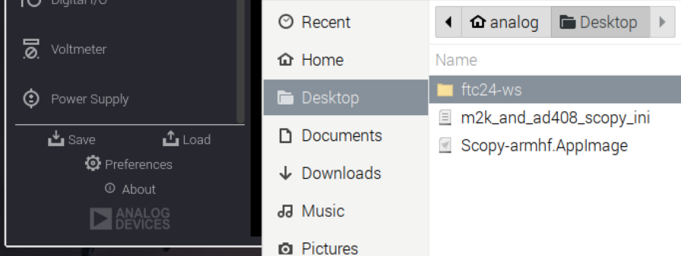
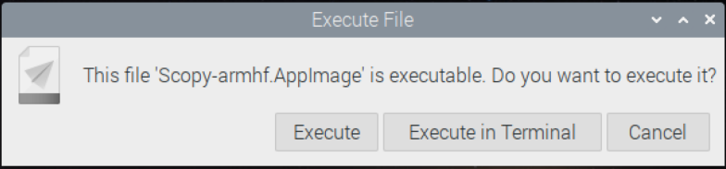
Fire up Scopy, connect to ADALM2000
Click the shortcut on the desktop
Click “Execute”
Connect to the m2k
Load profile (sets waveform gen.)
#3
#5 – select, click “Open”
#4
#1
#2

Slide 23
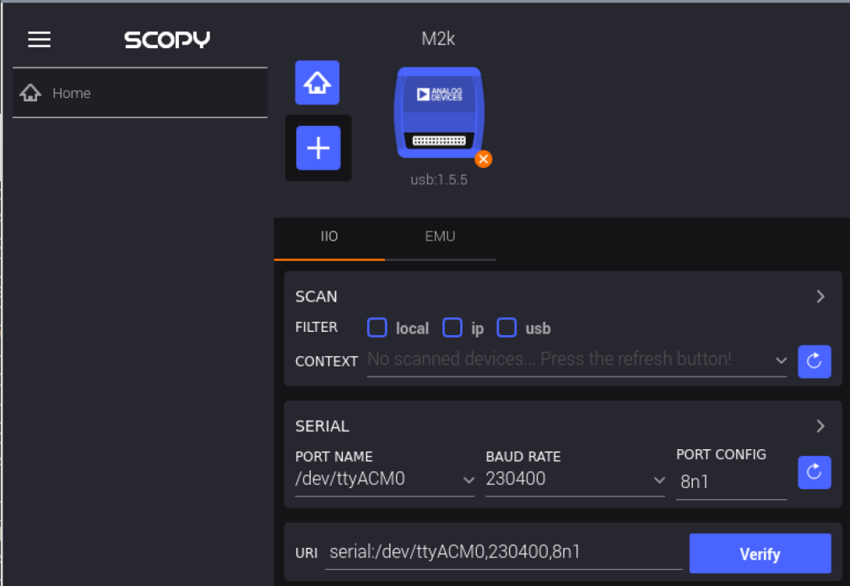
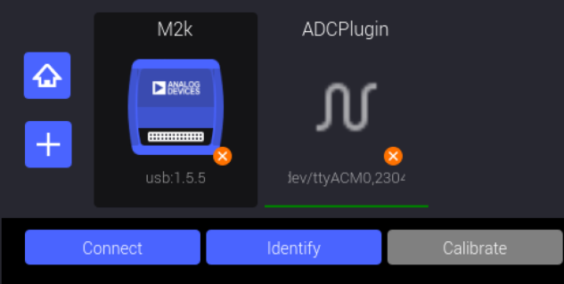

Connect to AD4080
We’ve already seen some of the AD4080’s attributes from iio_info, let’s look at them graphically…
Open Scopy, the m2k is already there!
Click the + button, select serial parameters
Click “Verify”
1) Enter params.
3) Click “Connect”
2) Click after verifying

Slide 24

Debugger Panel
Explore the context’s hierarchy
Take a peek at filter_sel, sinc_dec_rate, etc.

Slide 25

ADC Data!
Change buffer size to 4096
Click Start
Double-click instrument label to undock into separate window
Remember we’re driving differential inputs, you can disable one or the other by clicking its dot

Slide 26


Extra Credit: Observe SINC5+Comp. step response
Set FILTER_SEL to:
sinc5_plus_compensation
Set SINC_DEC_RATE to: 16
Set CH2 to square wave, 1 kHz, 1 Vp-p
Note that you can zoom in on a region of the waveform by selecting w/ mouse. Right-click to go back.
Also dot display option:

Slide 27

Extra Credit: CPU Thermal in Scopy
Try adding the “ip:localhost” context to Scopy
Head over to the debugger panel, How hot is your Pi running?

Slide 28

IIO Oscilloscope is… “being passively deprecated”! Long Live IIO Oscilloscope!
IIO Oscilloscope has served us well. But alas, all good things must come to an end.
There are still some plugins that haven’t been ported to Scopy so it will be around for a while, but not forever.

Slide 29
Controlling “real” Test Instruments
(No offense, m2k)
Notes:
We are about to connect up a 12-bit signal source, and a drifty one at that, to the world’s “highest dynamic range per bandwidth” ADC. I hope it’s not insulted. But even at 12 bits, the ADALM2000 is a fantastic “just get SOMETHING up and running” instrument. You can do proof of concept and get off the starting line on your kitchen table, then replace the m2k with your fancy Keesite or Roadie and Schvarts generators / analyzers when you get to the office, or your customer’s site..

Slide 30





Lots of options…
MATLAB
Python (of course), most based on PyVISA
LabVIEW – which we’re going to ignore
At least four repositories around the company, probably more:
https://github.com/PyICe-ADI/PyICe
https://github.com/sdgtt/pybench
From an old Python workshop (page dated 2019) https://www.secad.analog.com/sites/cas/docs/workshop/index.html
https://bitbucket.analog.com/projects/PKB/repos/adi_instruments/browse

Slide 31


LTC2387-18 testing
Sometimes the best isn’t good enough… Additional bandpass filtering is required to test the LTC2387!
Stanford Research SR1 plus handmade external filter
Not rocket science to control this thing via GPIB or Ethernet. Here’s a MATLAB snippet for setting freq, amplitude. Similar in Python.
Also not rocket science to get a setup running with m2k while you’re waiting for the “real” instrument to free up.

Slide 32


Line regulation test from a previous project
Import PyVISA, open-source library for instrument control
Meter’s GPIB Address
Read voltage
32
©2024 Analog Devices, Inc. All Rights Reserved.
Notes:
For this test we used PyVISA to talk to an HP (Keysight) 34401A multimeter. PyVISA can be used with lots of other instruments, and for those that aren’t supported, there is likely some way to control from Python in particular, and other languages in general.
32

Slide 33
Case Study: capturing data from quad MxFE for advanced beamforming

Slide 34


Lab 7: MUSIC (From IEEE Radar Workshop )
MUSIC = MUltiple SIgnal Classification
Open the file “QuadMxFE_MUSIC.py” in the text editor, study the code, and then run the script
We are opening a recording of Jon moving transmitter “C”
So there is one moving emitter and three stationary emitters
Goal: After running the script as-is, try changing the number of expected signals so that it is incorrect, and see what happens
Stretch Goal: Add MVDR to the script, in order to compare the two
Notes:
Story time – Jon Kraft is a pretty exceptional FAE, but he’s not a software engineer.
In working with the PySDR folks on showing off how to use the Quad MXfE in a beamforming application, Jon was able to adapt the ~200 line pyadi-iio example to collect data, which he could then send across the country for analysis.
Eventually, wrapped up into a single script.

Slide 35


Quad MXfE pyadi example is a whopping 200 lines
That’s not too bad for one of our most complicated parts.
Snippets from the example are show to the right. Not too far removed from the AD4080:
Connect to device
Set up parameters
Capture data:
x=dev.rx()
Do some math
Save to file
Email data to PhDs.
(See https://pysdr.org/content/doa.html#music if you want to dig deeper)

Slide 36
Interacting with the AD4080 via Pyadi-iio
Notes:
Now let’s do the same thing with our AD4080, start controlling it and capturing data programmatically.

Slide 37



Scopy / m2k source, Pyadi-iio / AD4080 sink
Leave Scopy running
Open Thonny (Start – Programming – Thonny)
Load :
Desktop/ftc24-ws/hello_hw/hello_ad4080.py
Click Run:
The plot likes to take over the screen, so quit / restart if you want to play with different waveforms in Scopy
Close the plot, take a look at the end of the code. Simple? Complicated? Do you think your customer’s SW engineer could take it and run?

Slide 38
Performance Metrics with Genalyzer

Slide 39

Generating and Analyzing signals with Genalyzer
Notes:
See FTC2023 presentation – we started out making some interesting waveforms with LTspice, let’s do the same thing in Python, then analyze them with Genalyzer.
Now, let’s do this all with real hardware!
We aren’t going to dwell on the details of picking apart an FFT here. We just did the opposite (synthesis) in Ltspice, so hopefully that gave us an understanding of the basic math. Basically, sum up powers. Analysis is the reverse – deciding which frequencies are signal, which are noise, and which are harmonics, and comparing the total power of each.

Slide 40



Bindings, examples, etc.
Use Genalyzer in bespoke test code, automated test scripts, wherever you need quantitative data converter analysis.
C++ library with C, MATLAB, and Python language bindings, using a common shared library
SNR, NSD, THD, SFDR, etc. with Lots of examples

Slide 41
Putting it all together: Pyadi-iio, libm2k, Genalyzer

Slide 42

A complete example: Pyadi-iio, m2k source, AD4080 sink
Close Scopy
Load Desktop/ftc24-ws/hello_genalyzer/m2k_source_ad4080_sink.py
Click Run:
A (quite) imperfect test signal is defined on lines 22 to 35. Try reducing harmonic and noise tones, is it reflected in the plot and SNR/THD output in the shell?
Try setting all harmonic and noise amplitudes to 10x dB lower (-230 dB, for example), effectively zeroing them out.
With all imperfections zeroed out, what are we measuring the performance of?
Could your customer hook up their own generator and take this and run?

Slide 43
Digging Deep into DSP Concepts

Slide 44

Exploring the AD4080’s filter response, noise, aliasing
Open:
Desktop/ftc24-ws/hello_genalyzer/sinc_folding_interactive.py
Fun with noise and filters!
This is out of scope for the focus of this workshop, but it turned out so well, we can’t resist sharing.
You get the idea – we’re creating a little band of noise that we can slide around and see the AD4080’s filter at work. When the noise is above fs/2, it aliases back into the first Nyquist zone, but attenuated by the filter!
We’re testing other little DSP concept programs for future use in signal chain seminars.

Slide 45
Application-specific number crunching – ObsPy Seismic Library

Slide 46


pip install obspy
ObsPy is a good example of a “customer analysis function”

Slide 47

Run some ObsPy data through m2k/AD4080
Open:
Desktop/ftc24-ws/hello_seismograph/seismograph.py
The script opens an actual recording of a seismic event from the ObsPy examples.
It resamples the data to match one of the ADALM2000’s DAC data rates
Then “plays back” the waveform, which is in turn captured by the AD4080.
A customer could use this setup to validate a seismic signal chain - super easy to make a 20 dB, 40 dB, 100 dB attenuator for verifying dynamic range.

Slide 48


An old seismic application experiment
Send waveform through an actuator
Measure actual geophone response

Slide 49
Let’s look at some C code!

Slide 50
Hello, cpu_thermal
The simplest possible C program that talks to an IIO device, doesn’t even need any external hardware.
But it also works with an LM75, literally chaging the text cpu_thermal to lm75.
Procedure (note that the commands are in the text file from earlier):
Open a terminal
cd Des<tab>ftc<tab><enter> (autocompletes to Desktop/ftc24-ws)
cd hello_iio<enter>
ls -la<enter> (Take a look around)
geany hello_iio.c (Take a look around, then close Geany when done)
cat how<tab>d<tab> (autocompletes to how_2_build_cmdline.txt)
Copy the gcc hello_iio.c -o hello_iio –liio using CTRL-SHIFT-C (don’t forget the shift!)
CTRL-SHIFT-V to paste, <enter>
ls –la<enter> (Notice a green file, the “x”s mean it’s executable!)
./hello_iio<enter> (We have both kinds of degrees!)

Slide 51

Compile from command line, Cmake, Make
Overachievers:
cat how_2_build_cmake.txt
Follow directions.
This is typical when building Linux programs from source. For example, to build the libiio:
(Don’t type the below, it’s just an example)
~/libiio$ mkdir build
cd build
cmake ../
make
sudo make install

Slide 52
In Between ADALM2000 and “Real” generators: Sound Cards

Slide 53


FTC 2022 demo: Simple, Affordable, ADC metrics
$150 SoundBlaster G6, LT1469 preamp will get you “compellingly close” (within 10 dB) to ADAQ23878 datasheet performance
Use pyadi-iio (or MATLAB) and Genalyzer to automate test scenarios

Slide 54


pip install SoundCard

Slide 55
More IIO tricks ☺

Slide 56







Problem: 4 Plutos, Far Away, How To Connect Them?
USBx4
USBx4
Ethernet

Slide 57




What’s a “context”?
An IIO Context is “A collection of IIO devices”
Usually, one processing board represents one context.
An iio_context object may contain zero or more iio_device objects.
An iio_device object is associated with only one iio_context.
Quiz: How many contexts does the Phaser have?
Answer: Two – Raspberry Pi with the Phaser peripherals (ADAR1000, ADF4159, I2C housekeeping ADC, etc.) and the Pluto
Raspberry Pi
ip:pluto.local
local
(SPI bus)
(I2C bus)
ADAR1000 Beamformer
AD7291
AUX ADC
ADF4159 PLL
USB, Eth. over USB
ADAR1000 Beamformer
Notes:
There’s a lot of terminology associated with IIO, but the one we’re going to focus on for the next few slides is “context”. A Context is a “collection of IIO devices” connected to one “computing device”, like a Raspberry Pi, FPGA platform board, or even a microcontroller.
And a little quiz for those of you that have seen the phaser or attended one of our workshops – how many contexts does the phaser setup have?
The answer is two – there’s the Raspberry Pi that talks to the beamformer chips and the synthesizer over the SPI bus, as well as a little I2C housekeeping ADC. The other context is the Pluto, which itself runs a small but complete Linux system.
From the viewpoint of a program running on the Raspberry Pi, the stuff on the SPI and I2C bus are the “local” context, because they are connected directly to the Pi.
The Pluto is connected by a USB cable, and is accessible both through a USB backend and a network backend
So my Python program running on the Raspberry Pi can talk to everything just fine, and this is how we usually run the workshops, with a monitor and keyboard attached directly to the Pi, no external computer required.
BUT – often times we DO want to talk to the phaser from an external computer – the Pi has “limited processing power”, it can’t run MATLAB**, and certainly can’t run Windows applications.
** It is possible to generate C code from MATLAB that can be compiled to run on the Raspberry Pi, but there are limitations and you can’t run the MATLAB editor / IDE on the Pi.

Slide 58





Life before Context Forwarding
Raspberry Pi
SW development on Windows /Linux /Mac
Ethernet
ip:phaser.local
iiod
ip:pluto.local
(SPI bus)
(I2C bus)
ADAR1000 Beamformer
AD7291
AUX ADC
USB/Ethernet
ip:pluto.local
ADF4159 PLL
ADAR1000 Beamformer
USB, Eth. over USB
Notes:
Even during the initial development of the phaser code, the Raspberry Pi quickly became a bottleneck. Other team members were using fancy IDEs like Spyder for Python development on their powerful laptops, and we knew from the start that we’d need to support MATLAB and other development environments like VSCode, for various other languages.
And the solution was not terrible, but also not very elegant – connect to the Raspberry Pi via Ethernet, and pull the Pluto’s USB cable from the Pi and connect it to the host computer – two cables total.
The Raspberry Pi runs a little daemon program called “iiod” that forwards the local contexts (all locally connected devices) over a network backend, so the host computer can access the network context at ip:phaser.local
The Pluto looks just like it did when running code on the Raspberry Pi – it’s network context is ip:pluto.local (or a default ip address of 192.168.2.1).

Slide 59

Life after Context Forwarding
Raspberry Pi
SW development on Windows /Linux /Mac
Beamformer, PLL:
Ip:phaser.local,
Pluto shows up as
ip:phaser.local:50901
iiod -p 50901 -u usb:%i
iiod
(SPI bus)
(I2C bus)
ADAR1000 Beamformer
AD7291
AUX ADC
ADF4159 PLL
ADAR1000 Beamformer
USB, Eth. over USB
(Why not port 12345? See https://www.speedguide.net/port.php?port=12345 )
Notes:
Libiio 0.24 added the ability to forward any context – local, USB, serial, or network as an additional network context, with a custom port number.
This let us plug the Pluto back into the Raspberry Pi.
The phaser setup scripts set up UDEV rules that run the additional iiod process whenever the Pluto is plugged in.
So now code running on a remote host can access the phaser’s local devices via ip:phaser.local, and the Pluto via ip:analog.local:50901
I know we said plugging the Pluto into the host computer wasn’t terrible, but the single Ethernet connection is a LOT cleaner.
Why port 50901 and not something easy to remember like 12345? See https://www.speedguide.net/port.php?port=12345 . 50901 is somewhat arbitrary, but it’s in the ephemeral (temporary) port range of 49152 to 65535 and has no listed services.

Slide 60


Forwarding a serial context to MATLAB on Windows
Windows Subsystem for Linux
iiod
serial:/dev/ttyACM0,…
iiod on WSL built with serial backend support
adi.ad4080.Rx class
AD4080ARDZ
libiio bindings
ip:172.18.228.187
libIIO serial
serial:COMx,…
Libiio build packaged for MATLAB does not support serial backend

Slide 61





Other uses for port forwarding
Aggregate multiple Plutos over a single Ethernet connection
Aggregate and “Convert” serial contexts to network
192.168.2.1
192.168.3.1
192.168.4.1
192.168.5.1
Windows / Linux / Mac running MATLAB, Python, C, C# Etc. application
Ethernet
USBx4
Pluto #1 at analog.local:50901
Pluto #2 at analog.local:50902
Pluto #3 at analog.local:50903
Pluto #4 at analog.local:50904
Raspberry Pi
iiod –p 50901 –u ip:192.168.2.1
iiod –p 50902 –u ip:192.168.3.1
iiod –p 50903 –u ip:192.168.4.1
iiod –p 50904 –u ip:192.168.5.1
(hostname analog)
Notes:
So here’s another use for context forwarding, say you’ve got four Plutos on the other side of your lab and you want to develop an application that uses all of them
This setup allows you to keep the Plutos in one place, with short USB cables, and access them from anywhere.
4 Plutos unrealistic? What if you had a Pluto and some other transceiver – MXfE, Apollo, or some other random mix of devices?
The first step is to give the Plutos unique IP addresses, this is easy, just edit a text file in the Pluto’s mass storage device. You could do this with USB backends
The next step is to run four instances of the iiod, telling it which IP address to forward to which port
Each Pluto can now be uniquely accessed by appending its port number to the Raspberry Pi’s IP address or hostname.

Slide 62


Also works on serial backend
Aggregate multiple Plutos over a single Ethernet connection
Aggregate and “Convert” serial contexts to network
And a big one – MATLAB doesn’t support serial backend (yet?), here we can trick it ☺
iiod –p 50905 –u serial:/dev/ttyACM2,230400,8n1n
AD4080 SAR ADC eval board
ip:analog.local:50905
(SPI bus)
Raspberry Pi
Windows / Linux / Mac running MATLAB, Python, C, C# Etc. application
(hostname analog)
Ethernet
ST Nucleo running tinyiiod server
USB “virtual” tty/ COM port
Notes:
Yet another use case – aggregating several serial backend devices. The “tinyiiod” is an embedded emulation of the “real” iiod that runs natively on Linux systems. It’s being used more and more for ADI evaluation boards, targeting platforms like the ST Nucleo and ADI’s own MAX32xxx processors.
Context forwarding provides another way to connect to these boards, whether to extend the reach beyond the maximum length of a USB cable, aggregate multiple devices, allow access from a host with limited or no free ports.

Slide 63
ACE

Slide 64






ACE & Industrial I/O Support
ACE as the PC Evaluation Software Tool
Provides product specific Board & Chip plug-ins
ACE has support for Industrial I/O
First product using this is AD4630
Board and chip plug-ins are due for release November 2021
A Generic IIO plug-in is also available
Can work with any IIO or tinyiiod based boards
Similar in nature to IIO Oscilloscope,
…but more analysis, data logging functions
…multiple simultaneous boards & acquisitions
Unlike a dedicated Board/Chip plug-in
No Product specific board/chip view, configuration/control
Lacks register/bit field detail and documentation

Slide 65








ACE - ‘Plug-n-Play’ Evaluation
System View
Chip View
Analysis Views
Board View
Register View
Notes:
ACE is the ADI corporate standard user interface platform and is now compatible with boards that run IIO.
Devices that have a full compliment of IIO-supported board and chip plug-ins have full support in ACE for managing the board firmware and/or binaries.
Therefore the customer does not need to independently configure the host platform using another tool.
Generic IIO plug-ins are capable of detecting and accessing any platform that uses IIO, but the customer must configure the board using another tool.

Slide 66
ACE - ‘Plug-n-Play’ Evaluation
Chip Level Configuration
Data Capture & Analysis, Vector Generation - Evaluation Board and/or Model Data
Auto-detect/Manually Add Hardware or run Offline without Hardware and/or Model support
Board Level Configuration
Register/Bit Field Configuration

Slide 67


Call to Action!
The next time you’ve got an instrumentation, ADC, DAC, or Sensor application, connect the dots between ADI’s infrastructure and the customer’s proof of concept.
How can you help get them off the starting line?
Is the eval board enough?
Software requirements?
Pre / post processing of data?
Remember – if you hook the customer’s software engineer, you’re IN!
Don’t have an immediate customer need? Go through this workshop again – the shopping list is short, and the material is released. (Or just ask, and we’ll mail you a setup to borrow.)
Questions about whether a part is supported in modern frameworks? Ask!

Slide 68

Parting Thoughts: Achieving Proficiency
For better or worse, most of us won’t instantly turn into software engineers.
Building minimal, but functional, proof of concept applications is a path to proficiency.
Theodore R. Thoren (a proficient engineer in his own right), upon hearing an explanation of the LTC2440 24-bit ADC:
“This sounds useful. I want to understand how it works. Can I make a model of it, out of wood, on my lathe?”
Raspberry Pi “RSOD” (Rainbow Screen of Death)

Slide 69

Acknowledgements
https://github.com/analogdevicesinc/libiio/graphs/contributors
https://github.com/analogdevicesinc/pyadi-iio/graphs/contributors
https://github.com/analogdevicesinc/libm2k/graphs/contributors
https://github.com/analogdevicesinc/genalyzer/graphs/contributors
And HDL, and Linux, And no-Os, And Precision Toolbox and probably a few others.

Slide 70
Questions?

Slide 71
Making VNC run faster…
Bullseye uses Weyland for its desktop which is really good, but also very slow when used remotely, via VNC or xRDP.
Helpfully, the old desktop is still there because Weyland does not play nice on < 4GB RAM.
If you mostly use your Pi remotely, as I do, you need to turn off Wayland, and the easiest way is:
sudo nano /usr/bin/startlxde-pi
find and change 2048 [there is only one] to something really big, for example 992048
What this is doing is if RAM > 2048 then use Weyland, else use not-Weyland.
I simply change it so that it always uses not-Weyland regardless of the amount of Ram

Slide 72
EZ case studies
(driver for AD7745/46 data acquisition using LABVIEW)
https://ez.analog.com/data_converters/precision_adcs/f/q-a/587001/driver-for-ad7745-46-data-acquisition-using-labview
AD9467 no os drivers microblaze data capture
https://ez.analog.com/microcontroller-no-os-drivers/f/q-a/587686/ad9467-no-os-drivers-microblaze-data-capture
Using iio already, wants to pull data processing into the uBlaze processor.

Slide 73





AD4080 Noise Equation Summary and Calculations
$$ADC Total RMS Noise=Histogram Standard Deviation$$
(Workable)
$\frac{6.9 lsb×6.0V}{2^{20}}=$39 µV RMS
$$ADC Total RMS Noise=\frac{ADC pp full scale}{\sqrt{8}×{10}^{\left(\frac{SNR}{20}\right)}}$$
(Preferred)
$\frac{6.0 V pp full scale}{\sqrt{8}×{10}^{\left(\frac{93.6 dB}{20}\right)}}$ $=$44 µV RMS
$$ADC Noise Density = \frac{ADC Total Noise}{\sqrt{\frac{Sample Rate}{2}}}$$
$\frac{\text{44 µ}\text{V} \text{RMS}}{\sqrt{\frac{40,000,000}{2}}}=$14 nV/ $\sqrt{Hz}$

Slide 74



Back-calculating the missing aperture jitter spec
$$Max SNR=−20∗log⁡(2π∗f_{in}∗t_{jitter})$$
$$t_{j}=\frac{{10}^{\frac{SNR}{−20}}}{2π∗f_{in}}$$
~89 dB @ 4 MHz
$$t_{j}=\frac{{10}^{\frac{89}{−20}}}{2π∗4e6}=1.4 psRMS$$

Slide 75



Nucleo / EVAL-AD4080 Setup
IMPORTANT – Blob Nucleo SB70, top side of board near processor pin 1
Upgrade firmware to V3.J15.M7
Drag-and-drop ad4080_stm32_nucleo_h563.bin to
Binaries here: https://jira.analog.com/browse/PCFW-1358
MD5: 637690BAD1D489A5429F8BC518336AAF
Blob (or 0-ohm 0603 resistor) EVAL-AD4080 R17, R39
This allows us to sniff the inputs of the AD4080 directly w/ ADALM2000

